Slide 1
New Lane
2nd Grade
Monsters
By Mrs. Grillo’s students

Slide 2
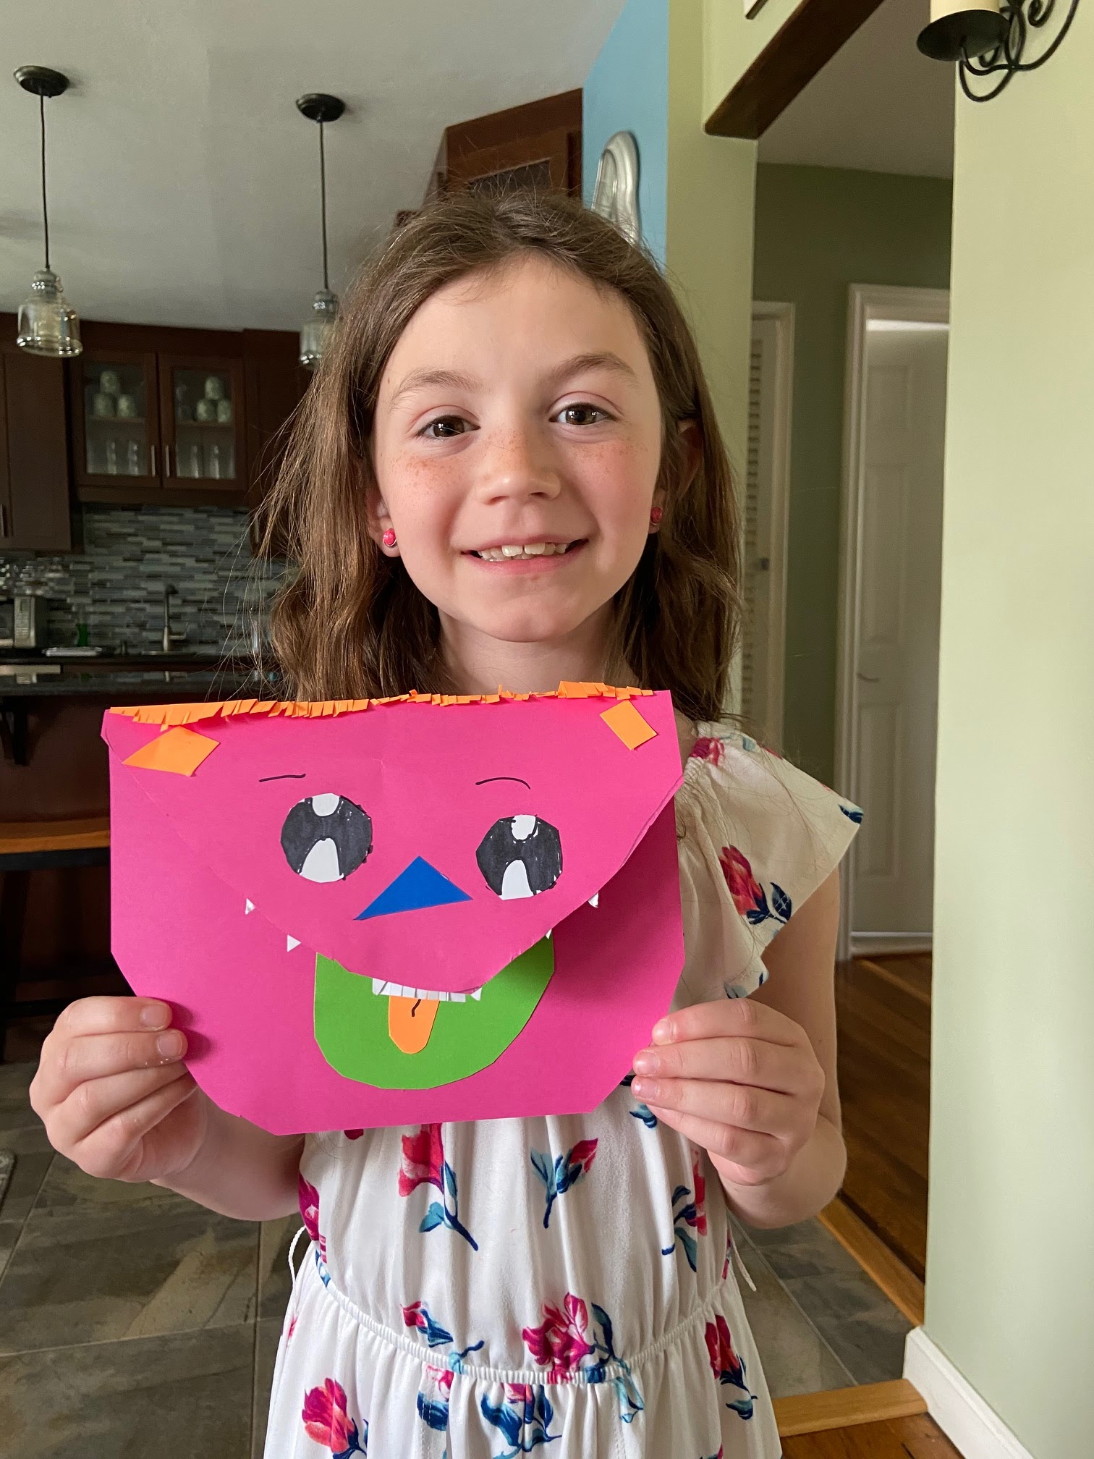
Natalie Zederbaum

Slide 3
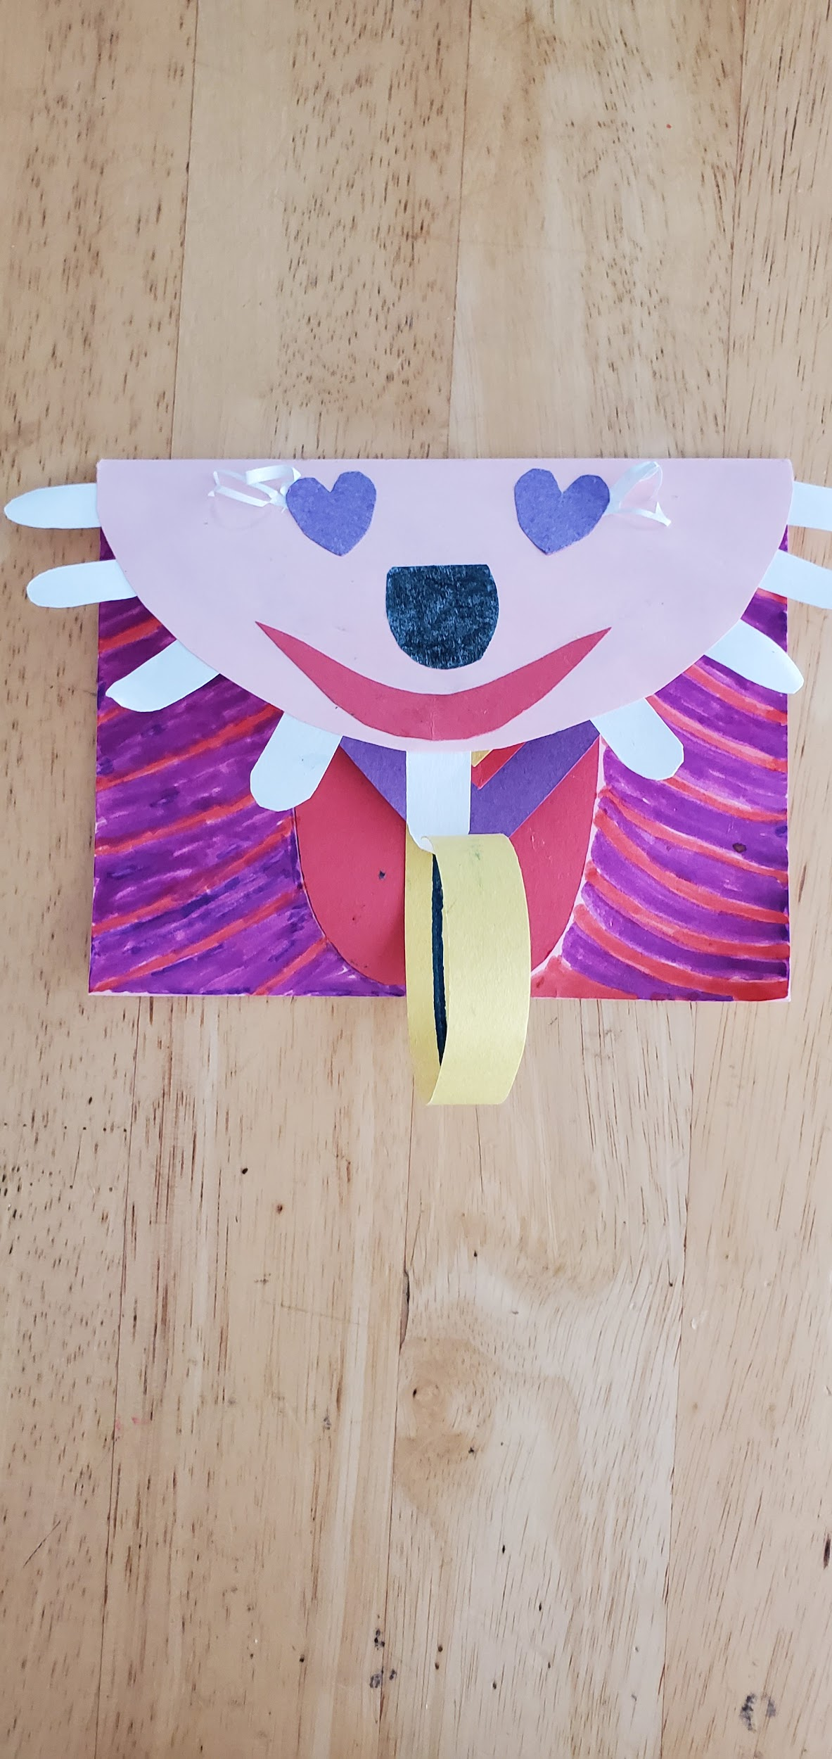
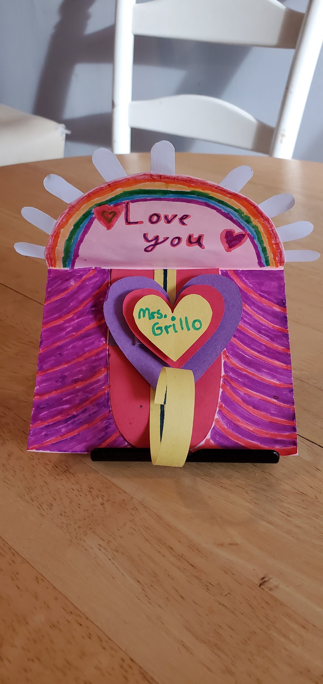
Samantha Nostramo
Samantha Nostramo

Slide 4
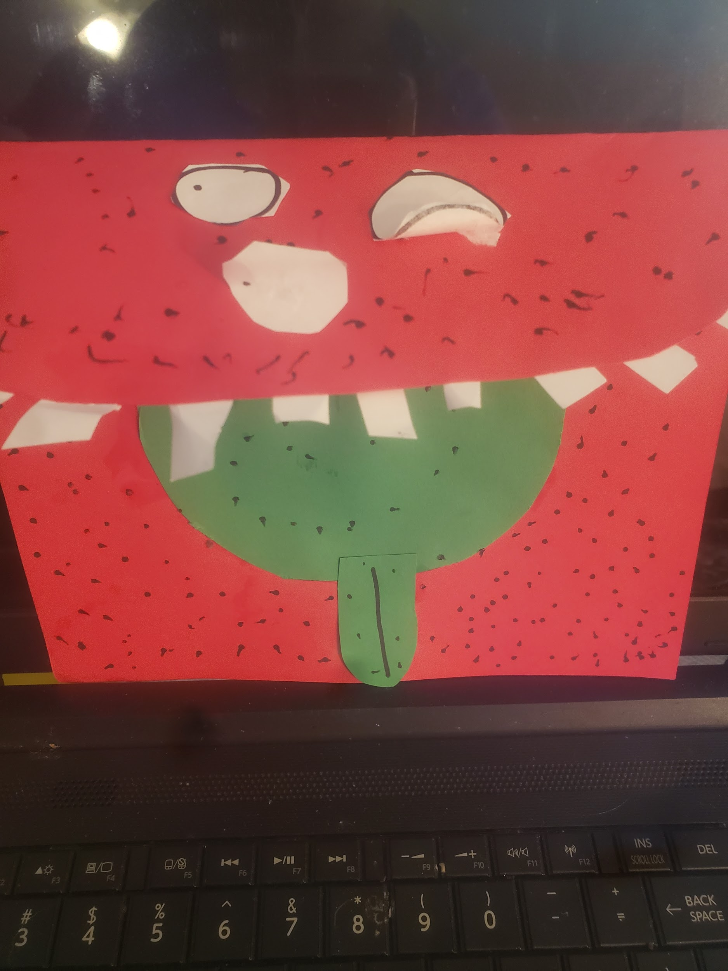
Phoebe Callace
Phoebe Callace

Slide 5
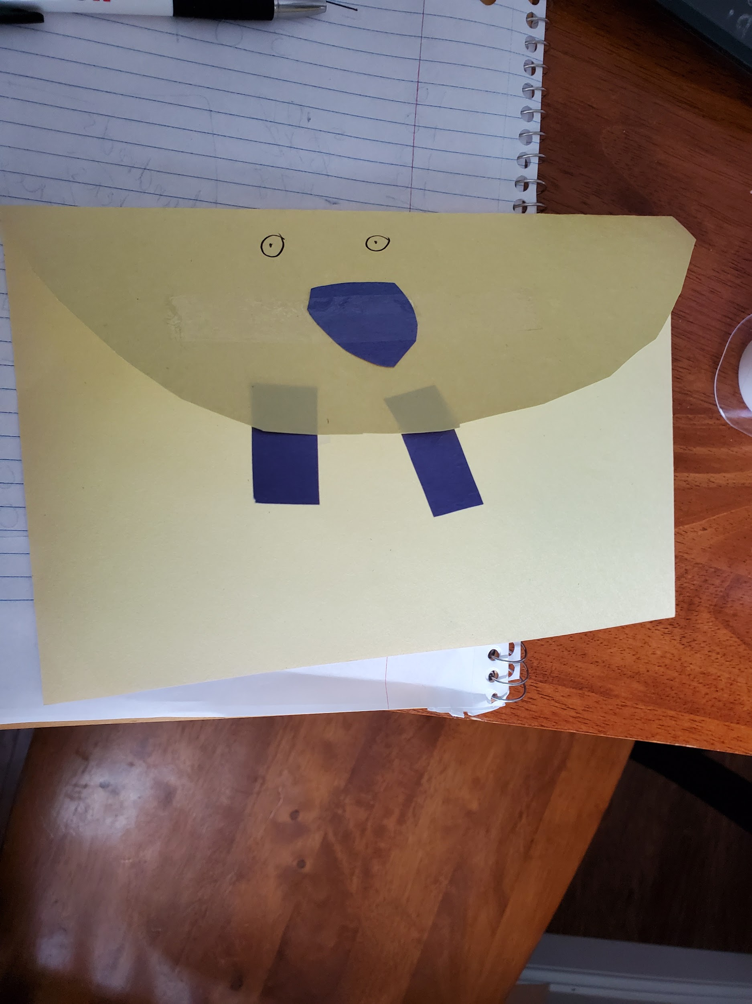
Ava Vujtech
Ava Vujtech

Slide 6
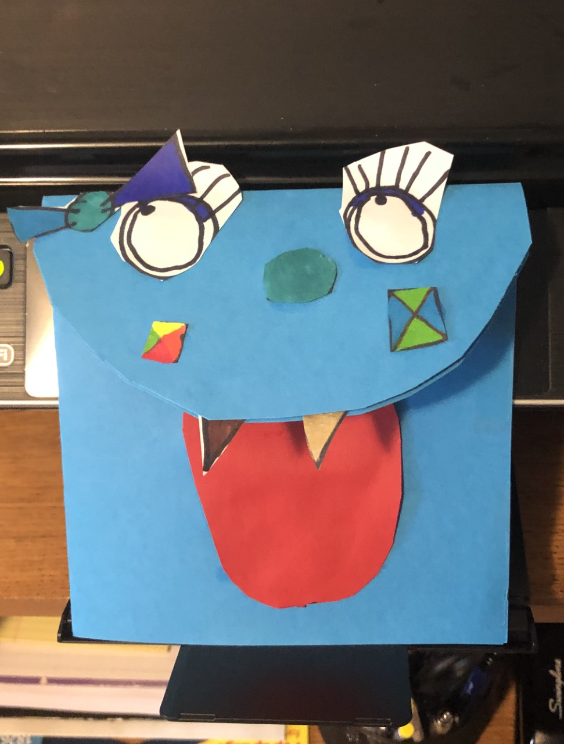
Autumn Ortiz
Autumn Ortiz

Slide 7
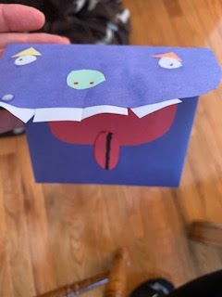
Jonathan Moehringer

Slide 8
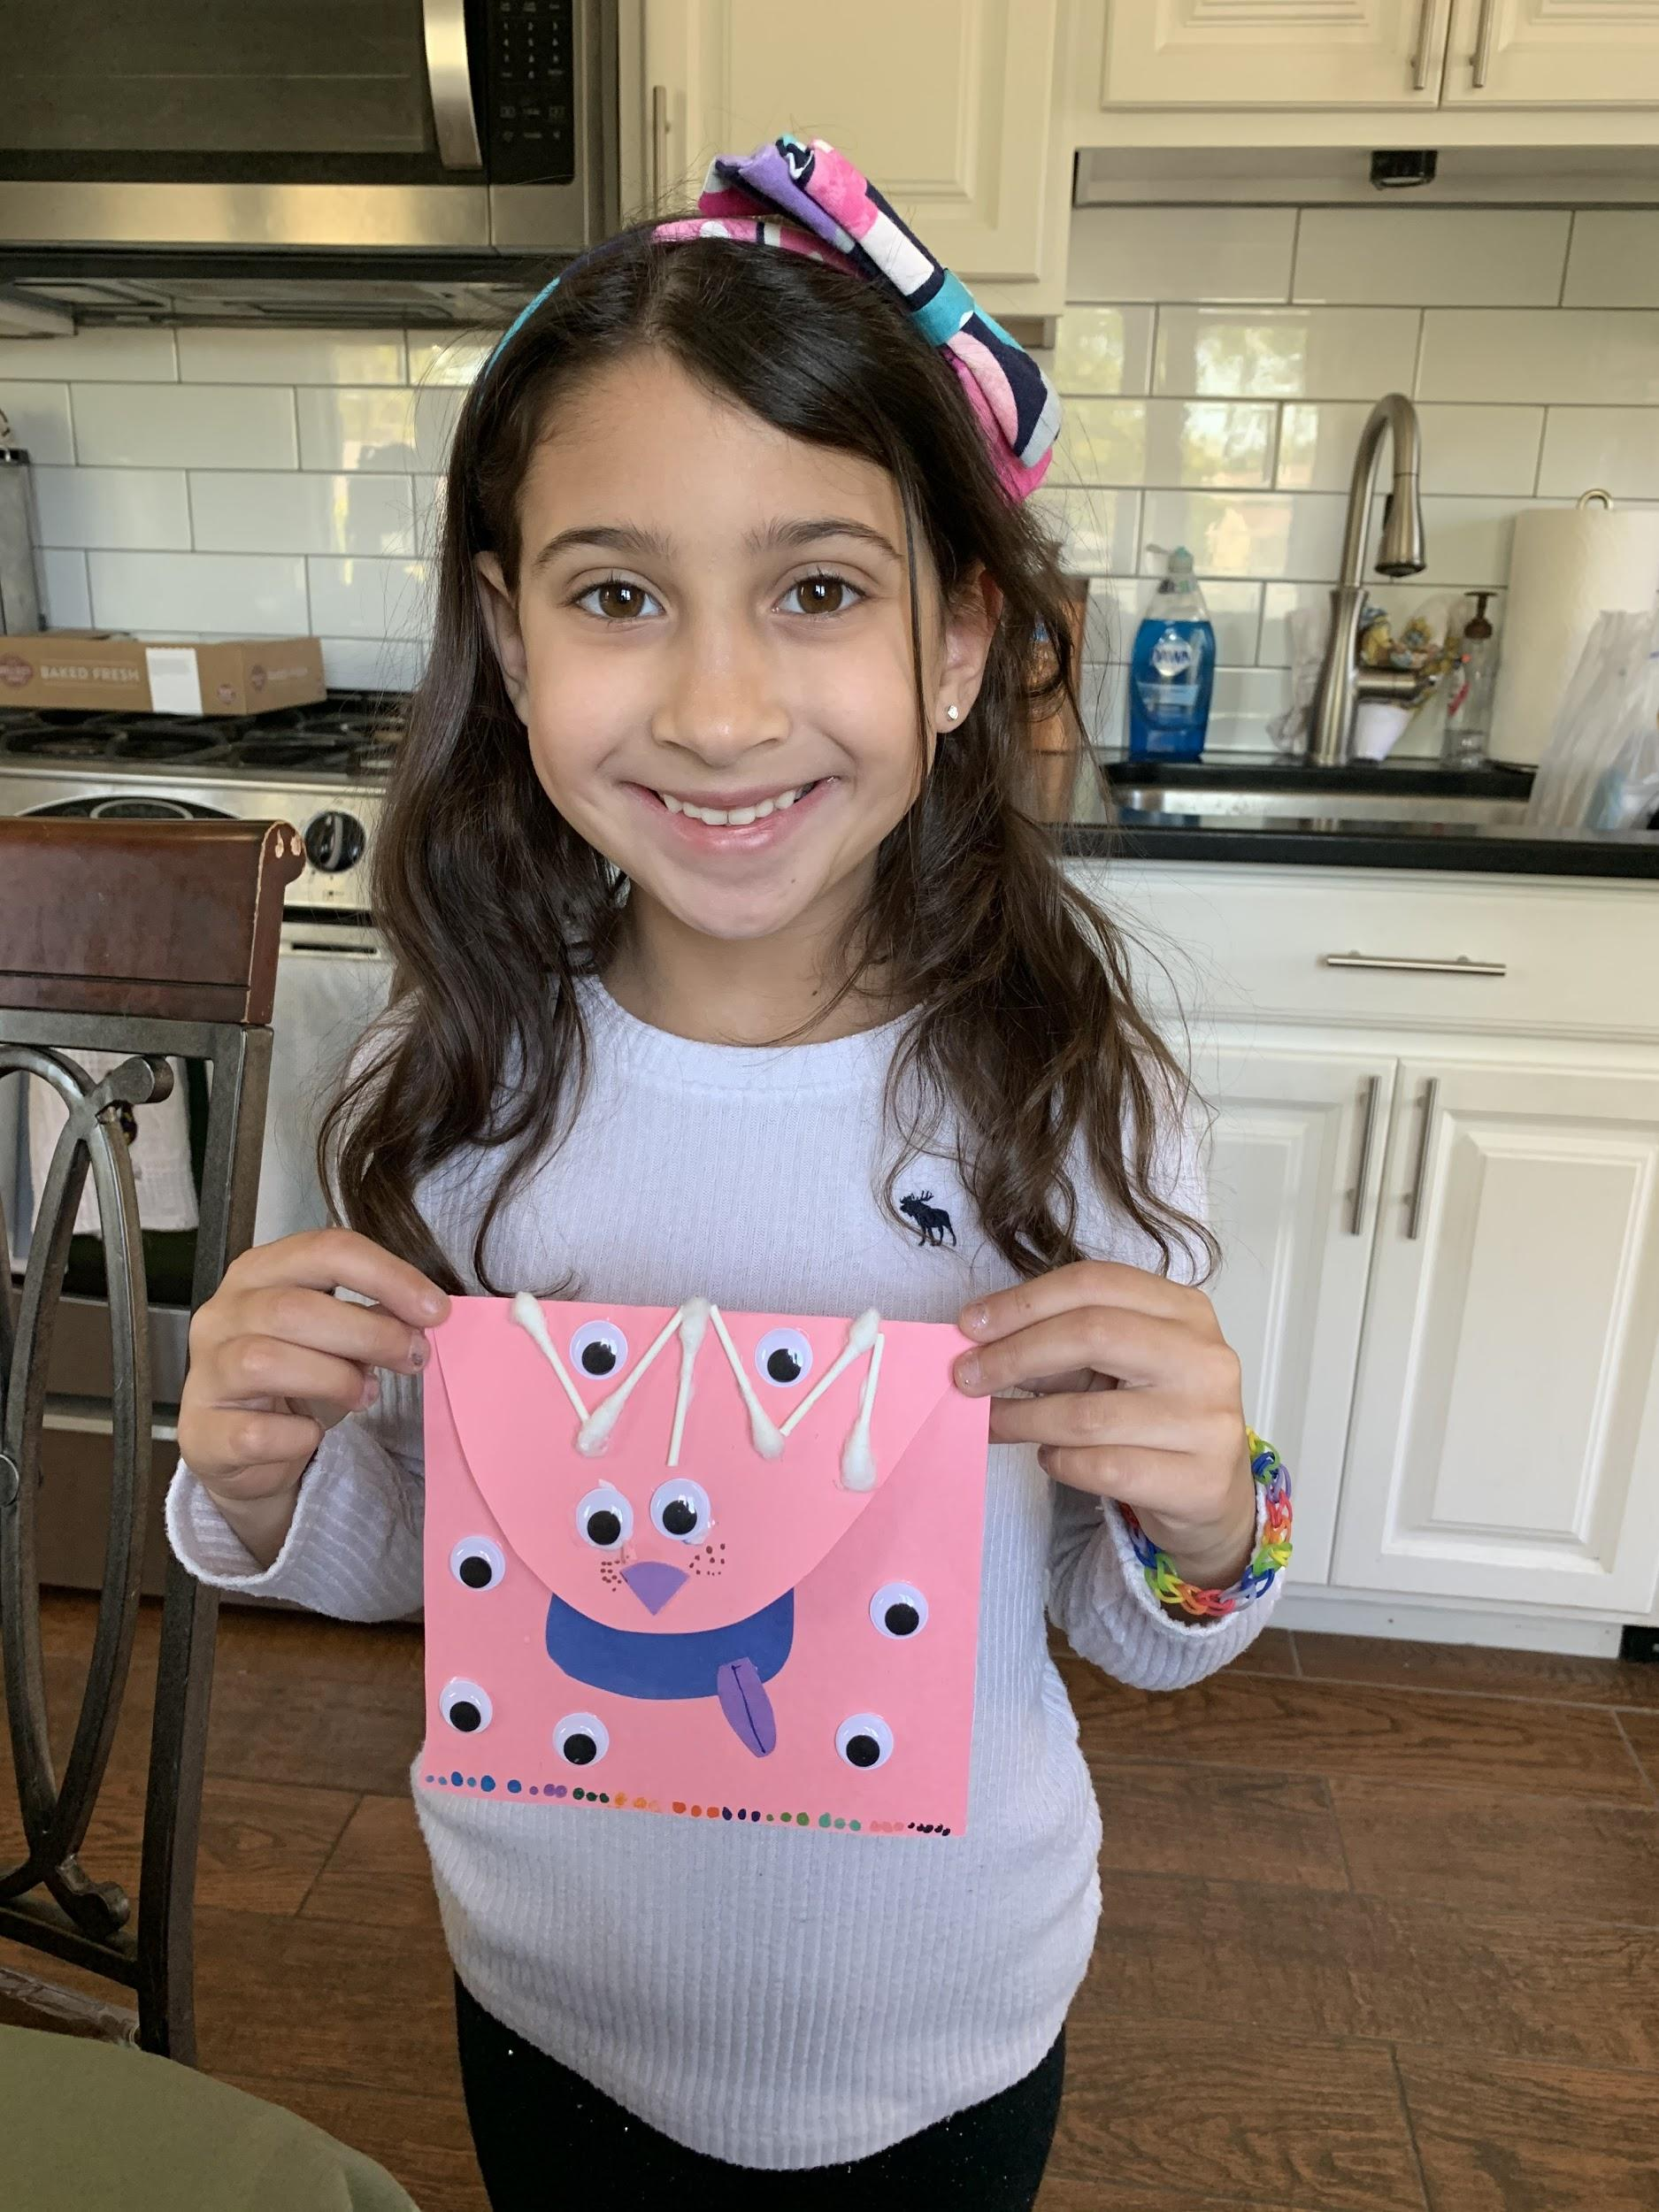
Kendall DaFonte

Slide 9
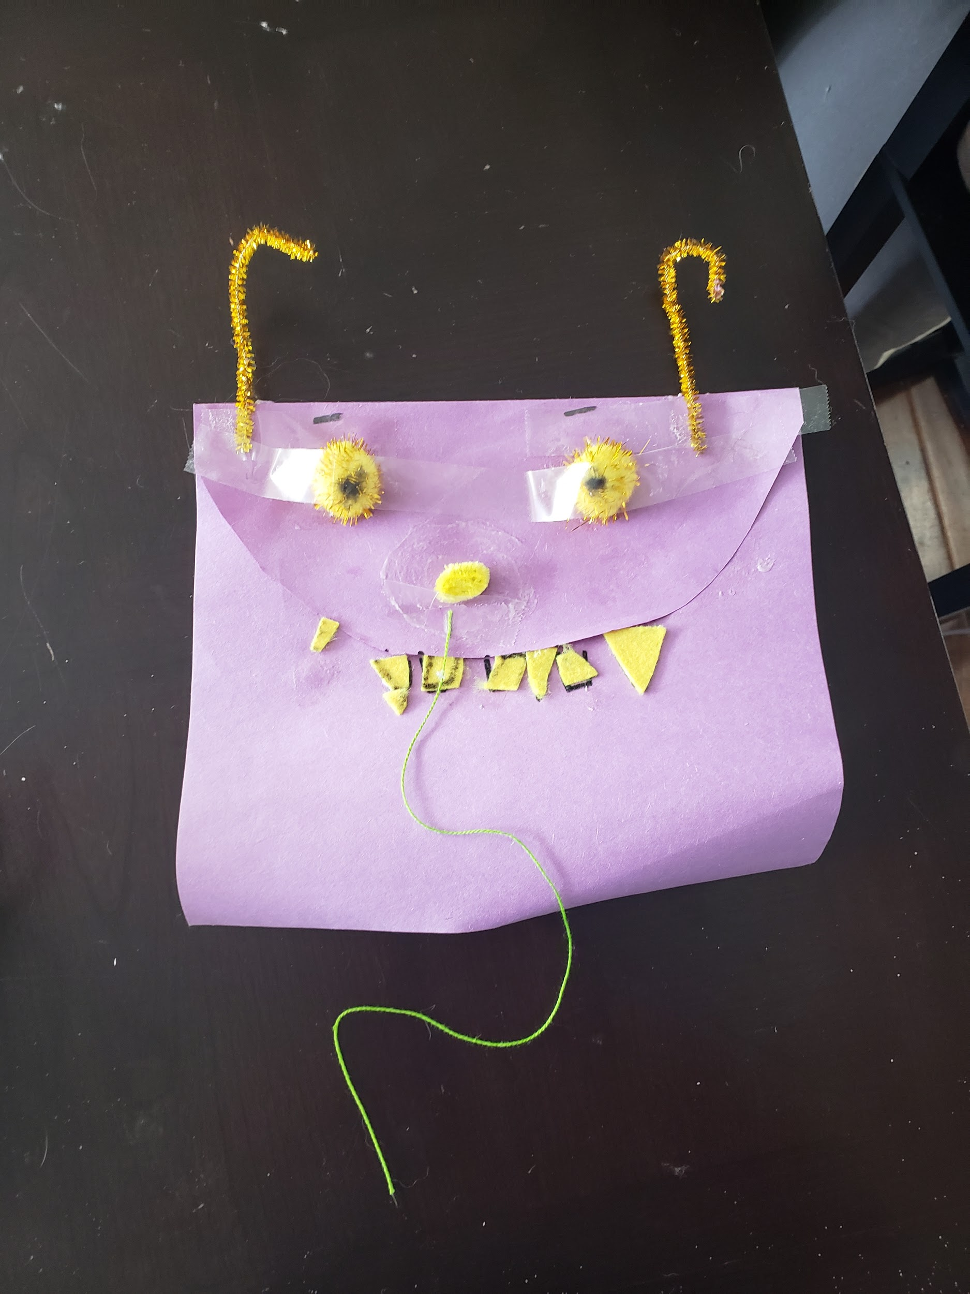
Madison Birkert
MAdison Birkert

Slide 10
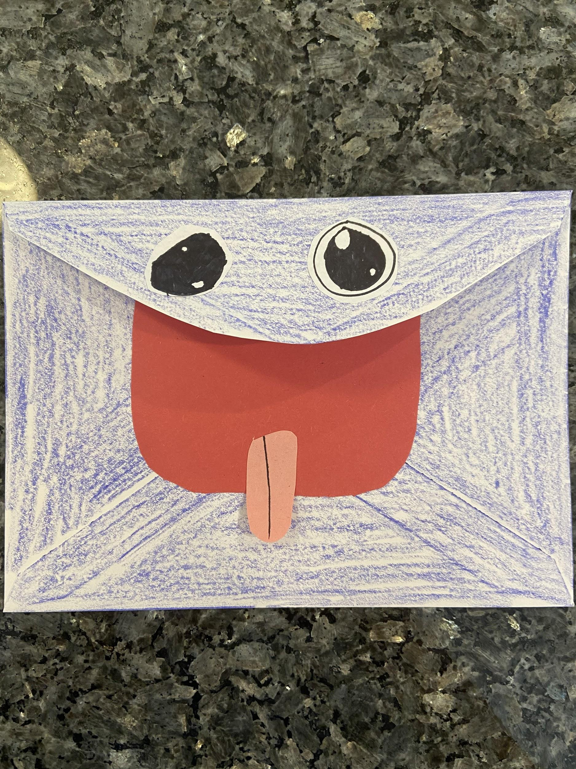
Brooke Barberio
Brooke Barbiero

Slide 11
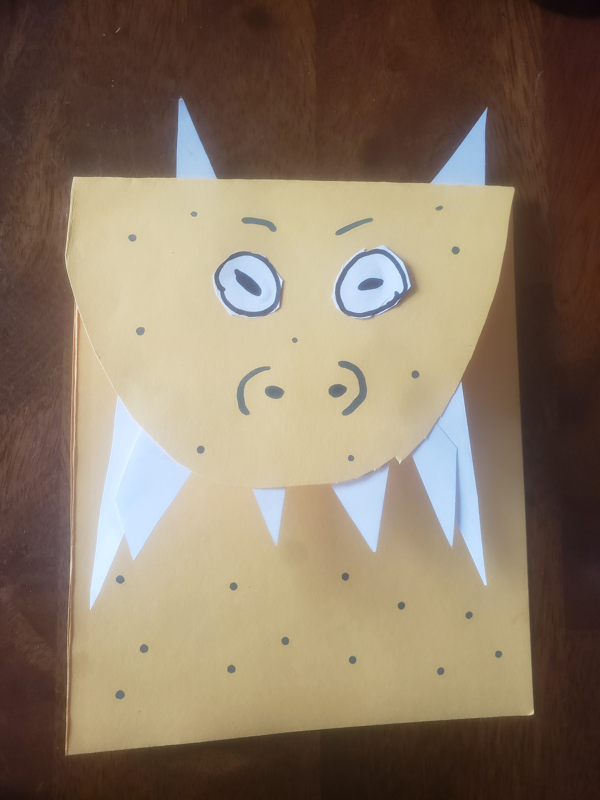
Joseph Bedus

Slide 12
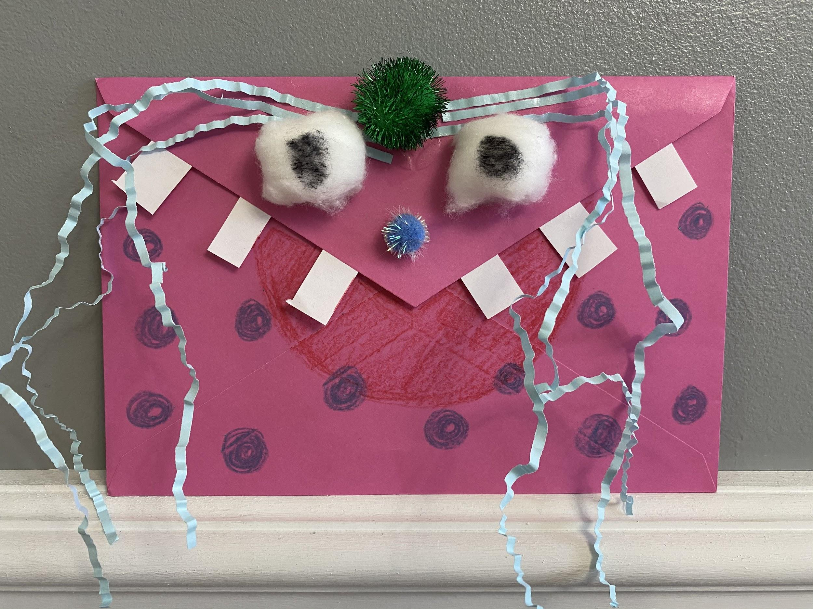
Amelia Sencadas

Slide 13
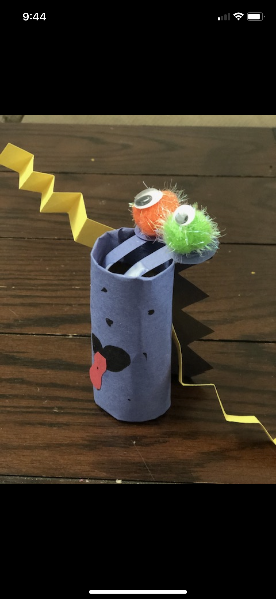
Griffin Latourell

Slide 14
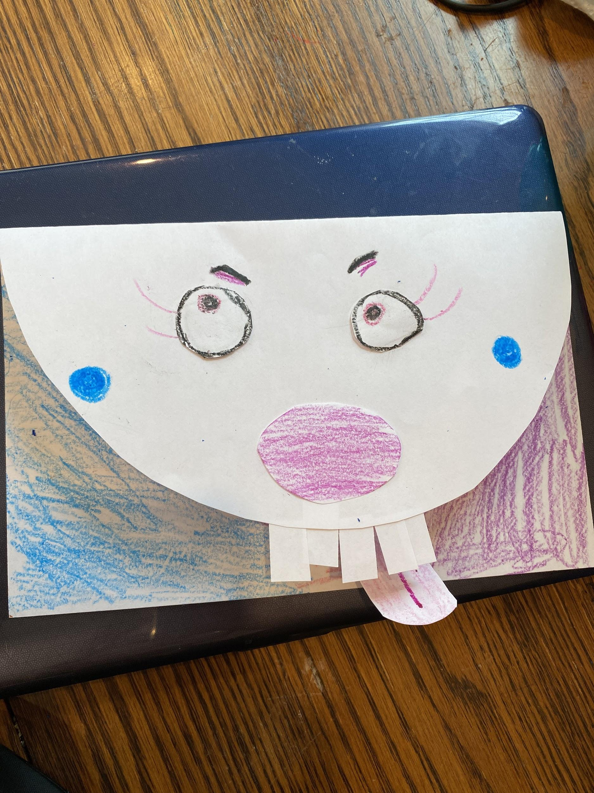
Ava Gersch

Slide 15
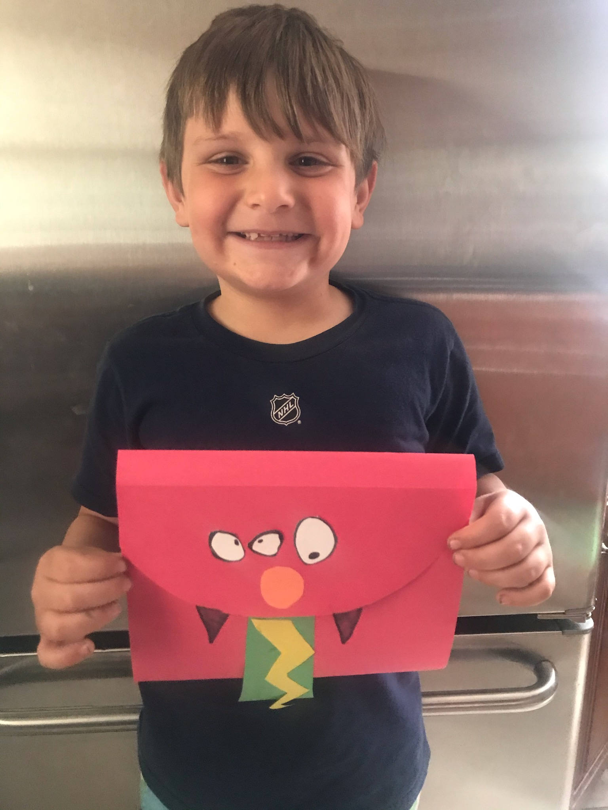
Dean Leoni

Slide 16
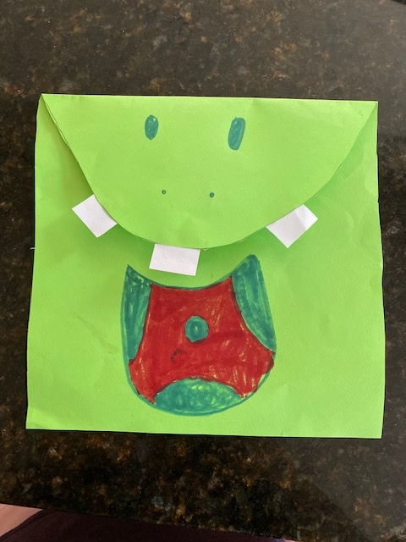
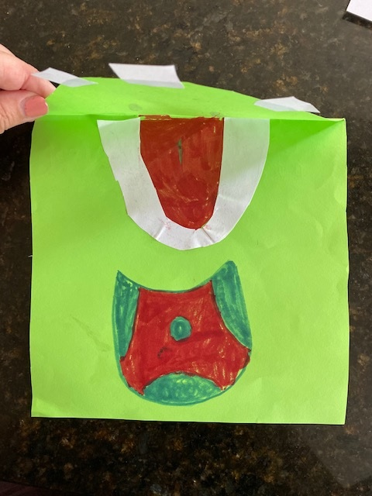
Coraline Chicarelli

Slide 17
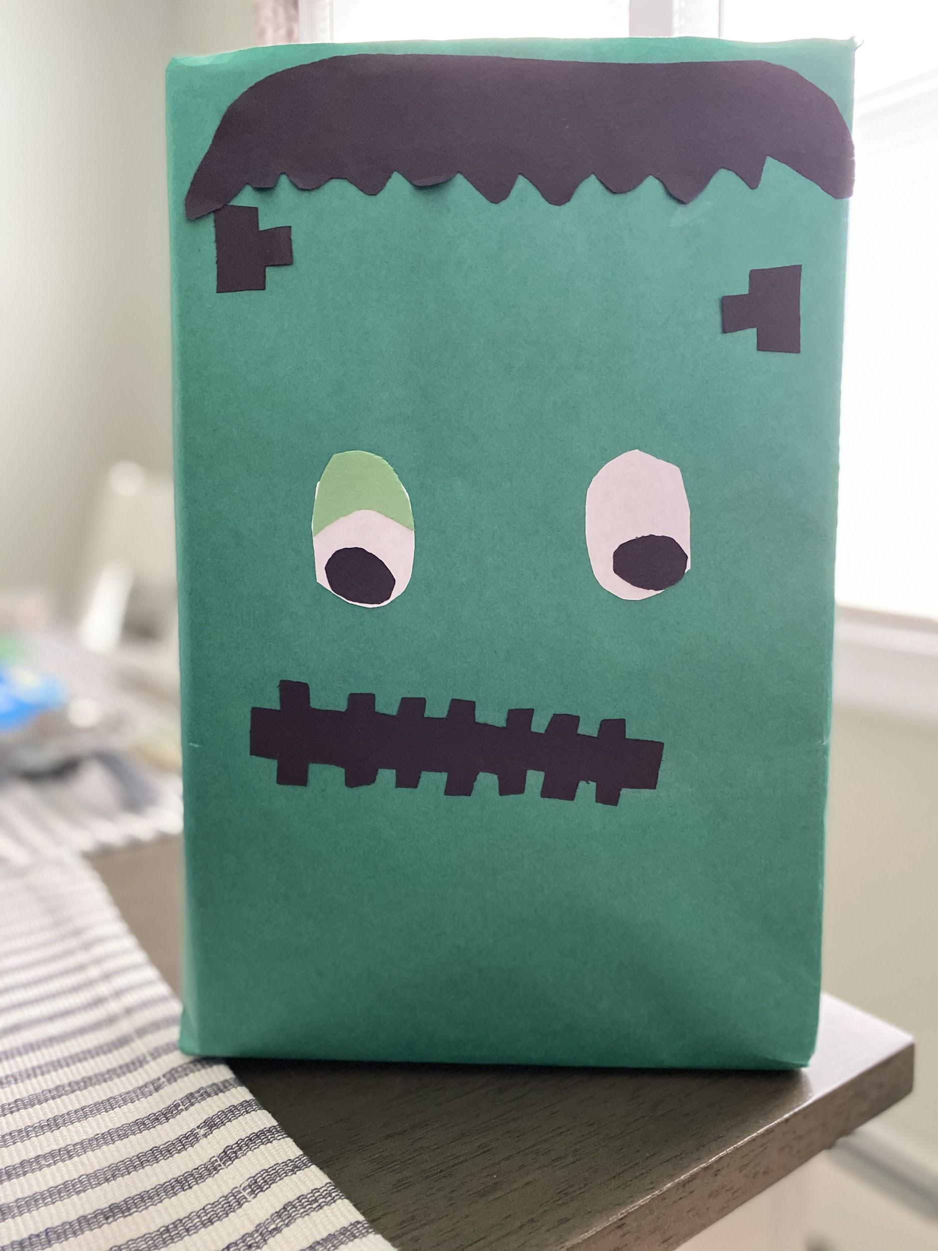
Isabella
Gonzalez

Slide 18
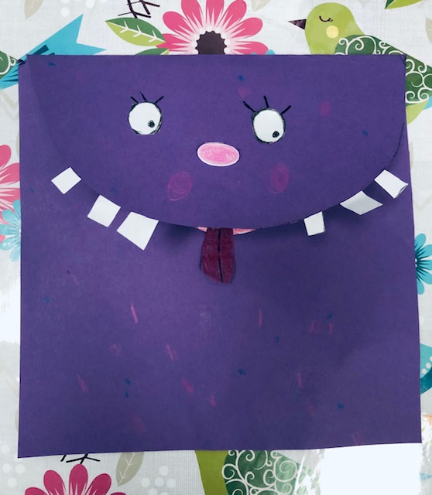
Alyssandra Conforti

Slide 19
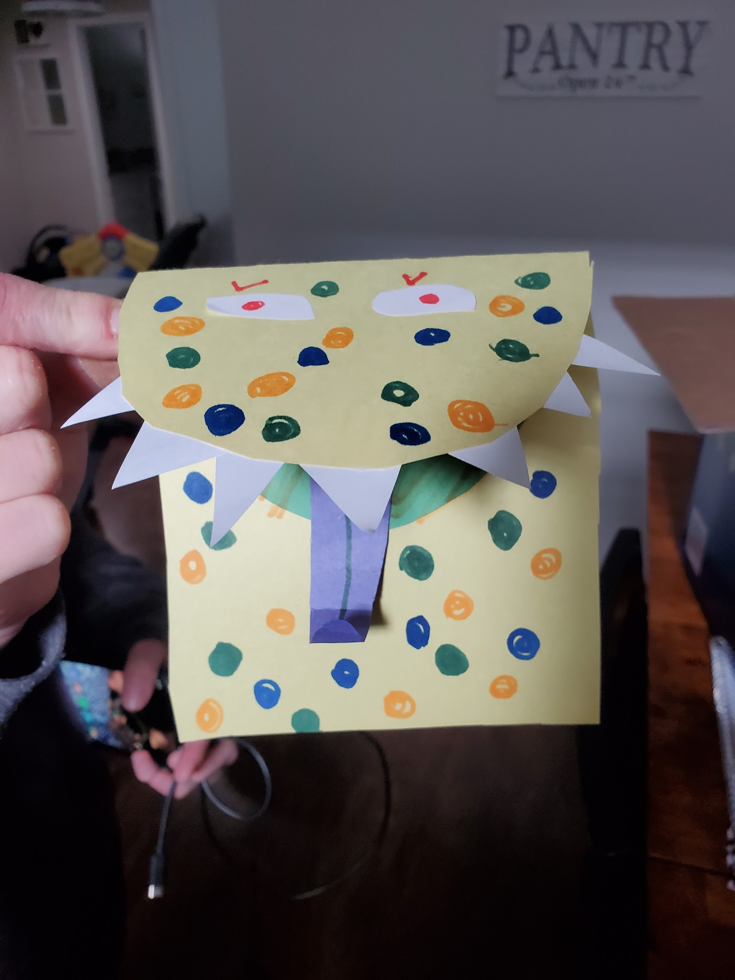
Sam Pesce

